Slide 1


The NIBM Student Management System
The NIBM Student Management System is an advanced database designed to optimize campus administration. Its primary purpose is to streamline critical tasks and enhance data management for the entire institution.
by Sudil Lakindu

Slide 2

Key Objectives
1
Centralized Data Storage
2
Enrollment Tracking
Consolidating all student information in a single, secure repository for easy access and management.
Efficiently managing student enrollment, tracking course selections, and monitoring class capacity.
3
Grade Recording and Reporting
4
Attendance Monitoring
Precisely storing and reporting student grades, facilitating academic progress tracking and reporting.
Streamlining attendance tracking for students and faculty, improving accountability and transparency.

Slide 3
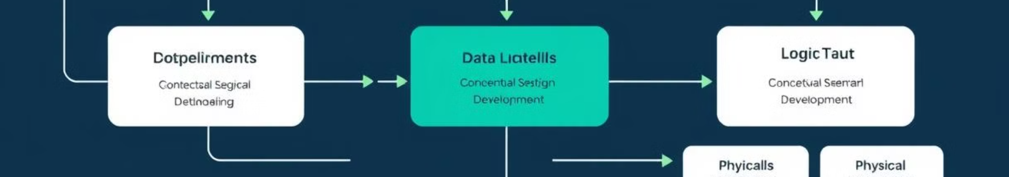
Database Design Approach
1
2
3
4
Requirements Gathering
Data Modeling
Schema Development
Implementation
Creating a logical representation of the data relationships, ensuring data integrity and consistency.
Creating the actual database structure and tables within the chosen database management system (MS SQL Server).
Identifying the specific data needs of the institution, including student details, course information, and administrative requirements.
Translating the data model into a relational schema, defining tables, columns, and relationships.

Slide 4
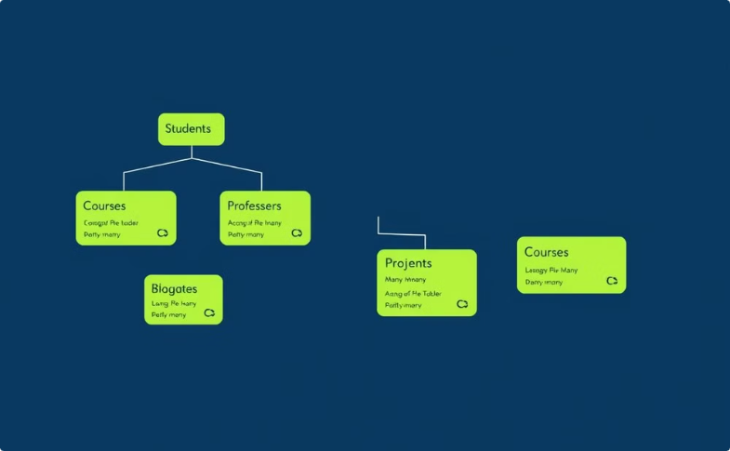
Conceptual Design: ER Diagram
Entity Relationship Diagram (ERD)
This visual representation outlines the entities within the system (e.g., Students, Courses) and their relationships (e.g., Enrollment).

Slide 5
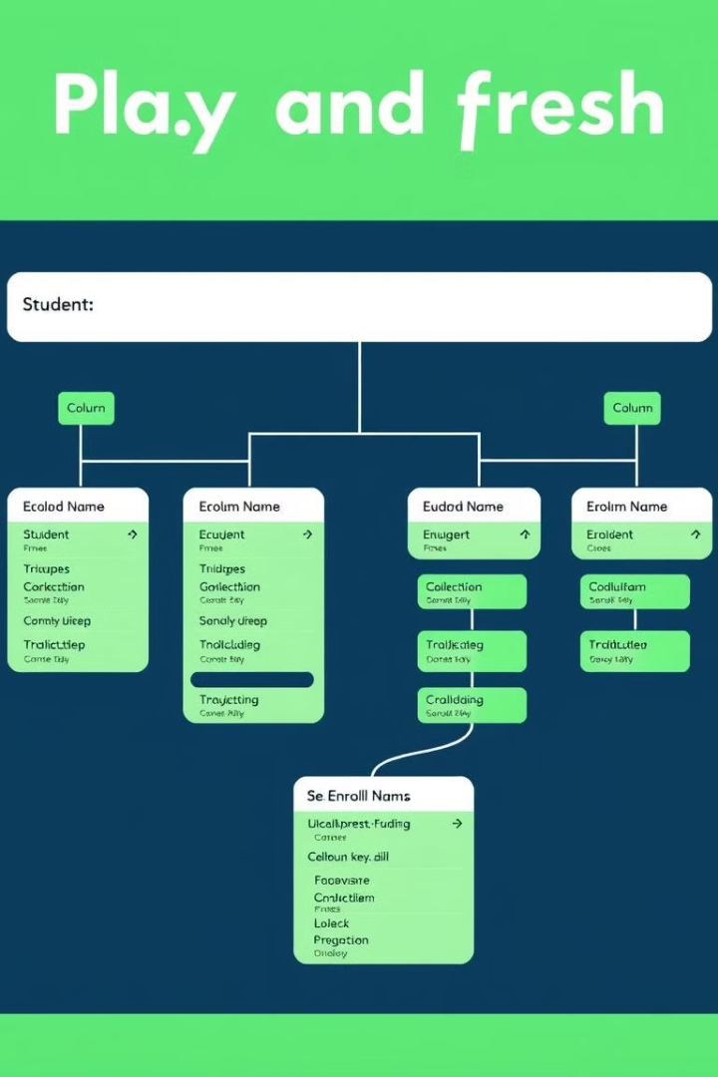
Logical Design: Relational Schema
Table Name
Columns
Data Types
Student
StudentID, FirstName, LastName, Email, Phone, Address
INT, VARCHAR, VARCHAR, VARCHAR, VARCHAR, VARCHAR
Course
CourseID, CourseName, Department, InstructorID, Credits
INT, VARCHAR, VARCHAR, INT, INT
Enrollment
EnrollmentID, StudentID, CourseID, Grade
INT, INT, INT, VARCHAR

Slide 6
Physical Design: Database Creation
Database Creation
Table Creation
Relationship Establishment
The physical database is created using SQL Server Management Studio, specifying the database name and other properties.
SQL statements (CREATE TABLE) are used to define the structure of each table, including column names, data types, and constraints.
Foreign key constraints are defined to link tables based on relationships specified in the ERD and relational schema.

Slide 7
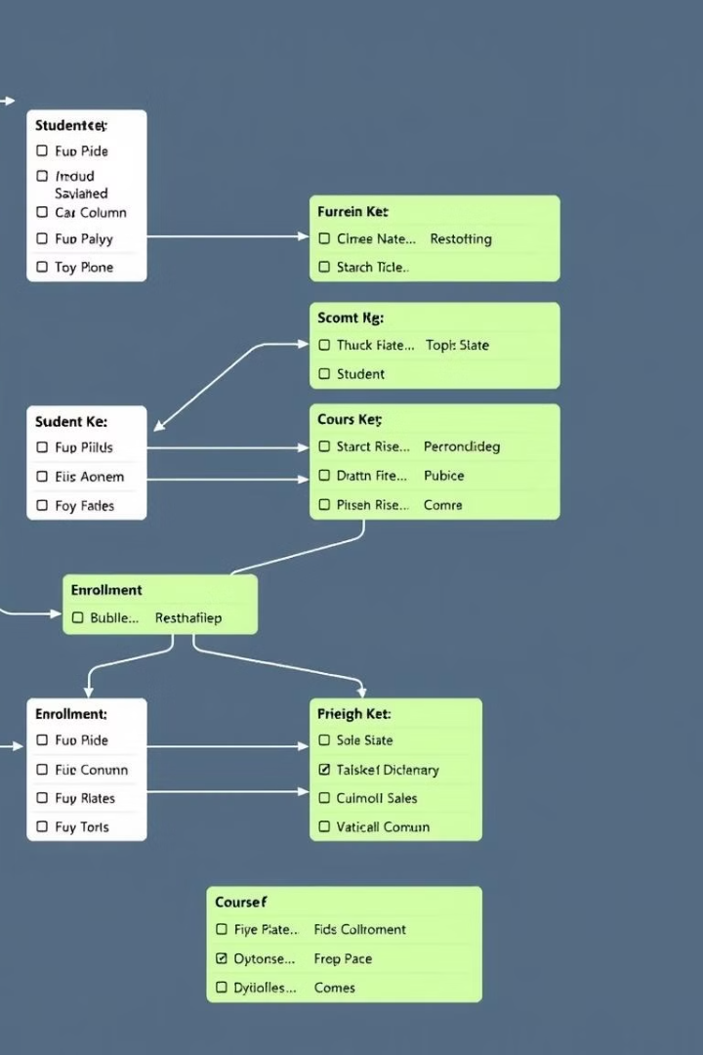
Table Creation and Constraints
CREATE TABLE Student ( StudentID INT PRIMARY KEY, FirstName VARCHAR(255), LastName VARCHAR(255), Email VARCHAR(255), Phone VARCHAR(20), Address VARCHAR(255) ); CREATE TABLE Course ( CourseID INT PRIMARY KEY, CourseName VARCHAR(255), Department VARCHAR(255), InstructorID INT, Credits INT ); CREATE TABLE Enrollment ( EnrollmentID INT PRIMARY KEY, StudentID INT, CourseID INT, Grade VARCHAR(2), FOREIGN KEY (StudentID) REFERENCES Student(StudentID), FOREIGN KEY (CourseID) REFERENCES Course(CourseID) );

Slide 8
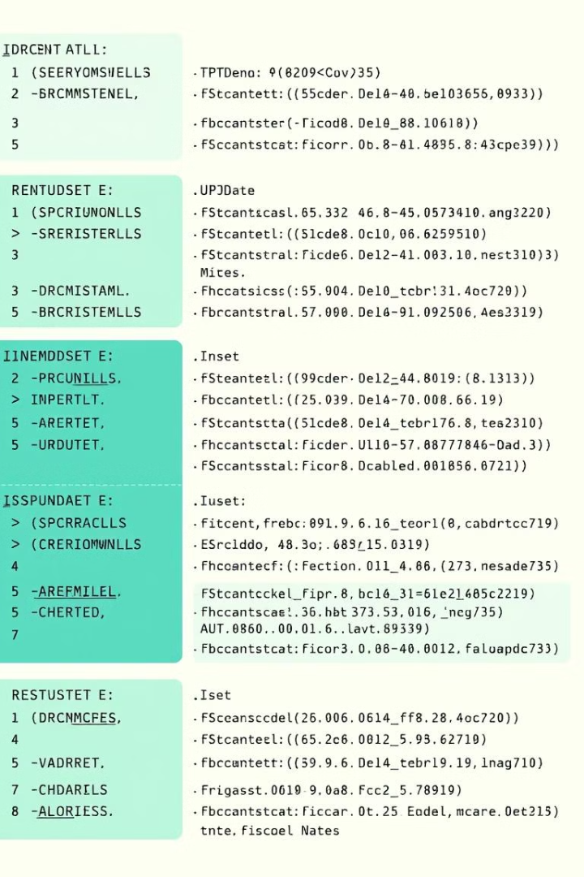
Data Manipulation (DML Statements)
INSERT
UPDATE
Used to add new records to tables. For instance, adding a new student or enrolling a student in a course.
Used to modify existing records. For example, updating a student's address or changing the grade for a course.
DELETE
Used to remove records from tables. This could involve removing a student from the system or deleting a course.

Slide 9



Data Control (DCL Statements)
GRANT
Used to assign specific permissions to users or roles. This enables controlled access to data based on user roles and responsibilities.
REVOKE
Used to remove permissions previously granted to users or roles, ensuring data security and integrity.

Slide 10





Advantages and Conclusion
Data Integrity and Consistency
Reporting and Decision-Making
Relational database design ensures data integrity through constraints, preventing data redundancy and inconsistencies.
The database facilitates data analysis and reporting, enabling administrators to make informed decisions based on accurate data.
Scalability and Adaptability
Security and Access Control
The system can be easily scaled to accommodate growth in student enrollment and course offerings, ensuring long-term sustainability.
MS SQL Server offers robust security features, allowing granular control over user permissions and data access.

